Slide 1

BUT Informatique S1
10th September 2021
The best way to secure your devices: a physical security key named YUBICO YubiKey 5 NFC
Colas NAUDI

Slide 2
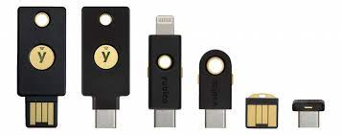
What is a Yubikey ?
How does a Yubikey work ?
A key that you can plug in any devices pc, macbook, iPhone, all others phones and computer server.
Firstly you need to link it to your main password or to your google password.
Secondly, when the key is linked, you need to always have it on you. Because now when you want to enter in your google account, even if it’s the good password it won’t let you enter.
Third, when your password is correctly write, plug your key and press the button on it, and it’s done.
Looks like a classic USB Key.
It is way more secure than a strong password.
2

Slide 3
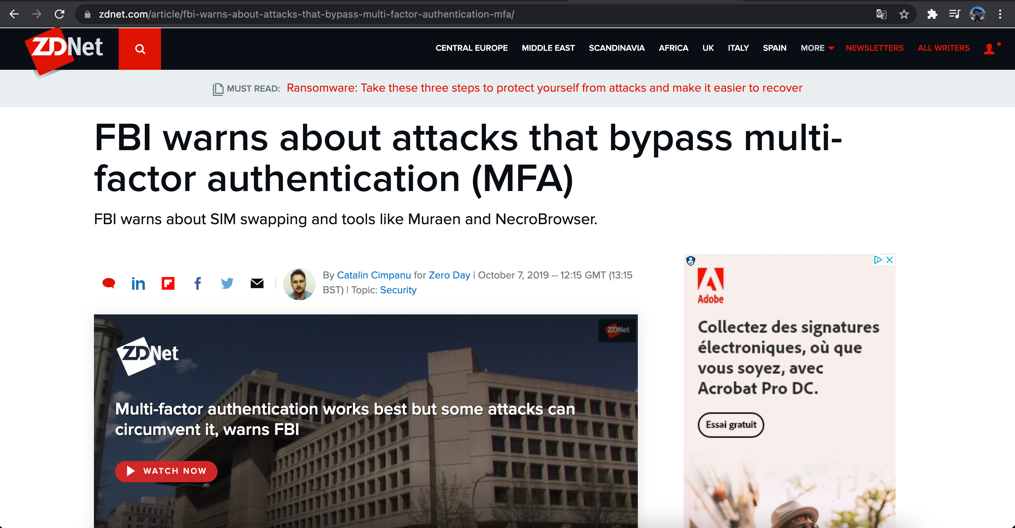
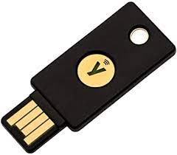
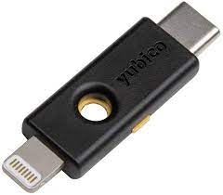
Why it is more secure more than other two factor authentication?
Where to buy a Yubikey ?
What’s the price ?
On the internet (Amazon, LDLC, Yubikey website…).
It costs from 45€ for the usb-A port and NFC to 70€ for the dual connector usb-c and lightning.
More secure than Google Authetificator :
USB-A and NFC
USB-C and lightning
Without having the physical key you can’t enter.
Sometimes people use the same password for many accounts, so if a hacker succeed to get one, he gets the password of all other accounts.
3

Slide 4
Thanks for listening
4

